Slide 1


Epi Recipes Visualization Application
By Kumara Swamy Kongari

Slide 2

Table of contents
Objectives
01
04
KPI & Dashboard
Resources
02
05
Recommendations
03
Charts & Visualizations

Slide 3


01
Objectives
of the project

Slide 4



Objectives
Our aim
The goal
Our aim is to explore and analyze various factors that influence people's enjoyment of food and cooking by examining a dataset of over 20,000 recipes. We seek to uncover insights from recipe ratings, nutritional information, and assigned categories to better understand what drives recipe popularity and satisfaction.
The goal of this project is to develop an interactive visualization tool that enables users to easily explore recipe trends, identify nutritional patterns, and evaluate the impact of different categories on recipe ratings. Future iterations will include additional data, such as recipe creation dates and ingredients, to provide deeper insights into food preferences and cooking habits.

Slide 5
02
Resources

Slide 6

Resources
Dataset
We will be using the EpiRecipes dataset from Kaggle, which contains comprehensive recipe-related information. This dataset includes details such as ingredients, preparation time, ratings, nutritional information, and sparse categorical data. The dataset provides a solid foundation for analyzing and visualizing trends in recipe popularity and user preferences.
Kaggle Dataset: (https://www.kaggle.com/datasets/hugodarwood/epirecipes )

Slide 7
03
Charts & Visualizations

Slide 8
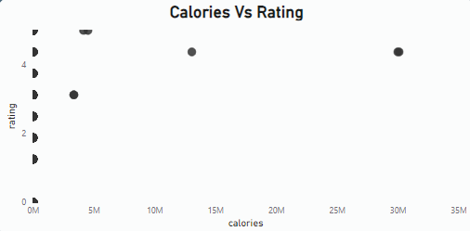

Calories Vs Rating
Analysis of Calories vs. Ratings
The analysis indicates a positive correlation between calorie content and recipe ratings.
As the calorie content increases, the ratings also tend to rise.
This suggests that higher-calorie recipes may be perceived as more satisfying or enjoyable by users, leading to better ratings.
This highlights the relationship between the richness of ingredients and the overall appeal of the dishes.

Slide 9
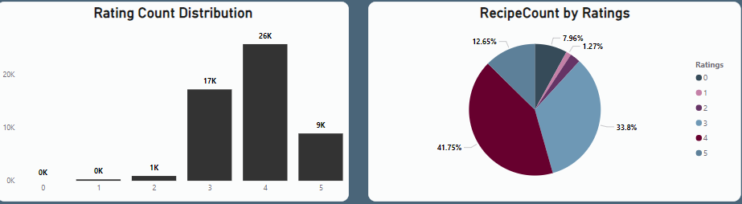
Rating Count Distribution Analysis
Rating Count Distribution Analysis
The highest total ratings were observed at rating 4, with 25,760 ratings.
Rating 4 accounted for 48.53% of all total ratings.
The lowest total ratings were at rating 0.
Across all 6 rating bins, total ratings ranged from 0 to 25,760.
Visual Insights:
The charts show that the majority of ratings were concentrated in the 4-rating bin, dominating the distribution.

Slide 10
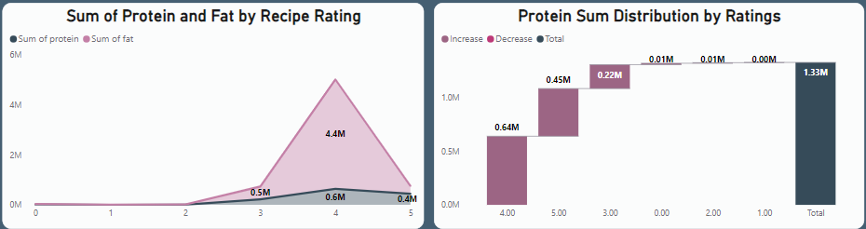
Protein & Fat Analysis
Protein and Fat Distribution Analysis
The highest sum of protein was at rating 4, totaling 641,083, which was 25,001.14% higher than rating 1 (2,554).
Sum of protein and sum of fat show a positive correlation, increasing together across ratings.
Rating 4 accounted for 48.19% of the total sum of protein.
The largest divergence between protein and fat sums occurred at rating 4, where sum of fat exceeded sum of protein by 3,738,820.
Visual Insights:
The charts highlight the dominance of rating 4 in both protein and fat distribution, and the strong correlation between the two nutrients.

Slide 11
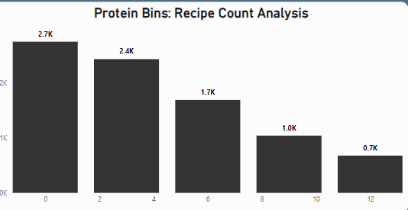
Recipe Analysis
Protein Bins: Recipe Count Analysis
The highest recipe count was in the 0 protein bin with 2,745 recipes, which was 305.47% higher than the 12 protein bin (677 recipes).
The 0 protein bin contributed to 32.00% of the total recipe count.
Recipe counts across the 5 protein bins (0:0-2, 3:3-5, 6:6-8, 9:9-11, 12:12-14) ranged from 677 to 2,745.

Slide 12
04
KPI & Dashboard

Slide 13



KPI dashboard

Slide 14
05
Recommendations

Slide 15



Recommendations
Promote High-Calorie Recipes : Highlight recipes with higher calorie content to enhance user satisfaction.
Focus on Popular Ratings (Rating 4) : Develop more recipes similar to those rated 4, as they attract the most engagement.
Promote High-Protein Recipes : Market recipes rich in protein to appeal to health-conscious consumers.
Optimize Recipe Recommendations by Protein Bin : With the 0 protein bin (0-2 grams) having the highest recipe count (32.00%), there’s an opportunity to create collections of low-protein recipes for users seeking lighter options, Conversely, promote recipes in higher protein bins to cater to those looking for protein-rich meals.

Slide 16
Thanks!
Do you have any questions?
youremail@freepik.com
+34 654 321 432
yourwebsite.com

